Slide 1
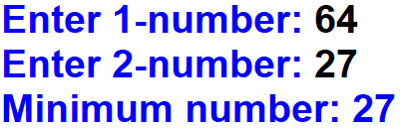
1. Ask from a user two numbers. And the program outputs the minimum number.
Output:

Slide 2
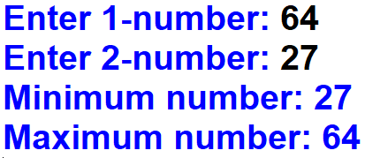
2. Ask from a user two numbers. And the program outputs the minimum number and maximum number.
Output:

Slide 3
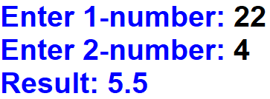
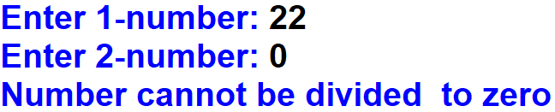
3. Ask from a user two numbers. And output the division of those numbers (1-number/2-number). If the second number is equal to 0 (zero), output that number cannot be divided to 0 (zero).
Output:
Output:

Slide 4
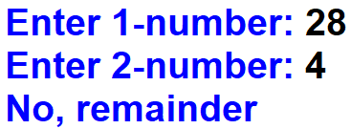
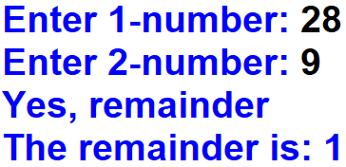
4. Remainder number
Output:
Output:

